Slide 1
ХВТ Fracturing fluid

Slide 2
Content
ХВТ
Introduction
Goal
ХВТ fluid system description
Comparison of gelling agents
Conclusion and proposal
Auxiliary materials

Slide 3
Introduction
ХВТ
Frac gellant agents in Russian market:
Short-term outlook for Russian market.
Guar based frac fluids | 99%
Other (VES). | 1%
Implementation of frac fluid based on synthetic polymer materials.

Slide 4
Goal
ХВТ
Goals of the project.
Pilot frac job with synthetic polymer. Result evaluation. Implementation of the new technology into Russian market.
Expectations:
Increase in production up to 15% with no increase of proppant quantaty.
Price stabilization for gelling agents in Russian market by limiting monopoly of international producers of guar (price sensitivity range= 10 times).
Reduction of dependences by localizing of production in Russia.

Slide 5
Description of ХВТ
ХВТ
ХВТ is a fluid system based on modified polyacrylamide gelling agent.
Base components:
Recommended fluid design:
6кг/м³ ХВТ-3,
2,4кг/м³ ХВТ-XL,
0,01-0,3кг/м³ braker
Type | Components | %
ХВТ-3 (gelling agent) | acrylamide, sodium acrylate, N-16 alkyl copolymer acrylamide, ammonium chloride | 75 25
ХВТ-XL (crosslinker) | Dodecane sulphonates, isopropyl alcohol, Water | 20 20 60

Slide 6
ХВТ fluid system description
ХВТ
No insoluble precipitates;
Fast gelation (less than 5 minutes);
Insensitive to bacteria, salt concentrations, water temperature;
Wide temperature range (20 -180°С);
Perfect shear elasticity;
Perfect post stress recovery (in perforation);
Significant reduction of friction (76% less, than for fresh water);
High proppant load at 20-50 сР.

Slide 7
Comparison of gelling agents systems
ХВТ
Type | Advantages | Disadvantages
Guar | availability proven technology price (in stable market) | Formation damage (up to 30% insoluble precipitates, fisheye) High requirements to water quality and temperature (long frac preparation) Limitation by formation temperature High viscosity (high pressure, equipment ware) Instable quality (guar from formed SU republics) Unstable price (depends on USD/RRUB rate) Complicated mixing (up to 10 additives)
SAS (VES) | No formation damage (if formation fluid compatible) No insoluble particles | Sensitive to formation fluid High requirements to water quality Required additional treatments (before and after pumping) Limited proppant load (800 кg/м3) Unstable at high formation temperature Sanctions to Russia High pricing

Slide 8
Comparison of gelling agents systems
ХВТ
type | advantages | disadvantages
ХВТ | No formation damage (perfect flowback) No insoluble residuals Perfect post stress recovery Wide formation temp range (20-180С) High proppant load range at low viscosity (low pressure) Low requirements to water quality and temp (reduced frac preparation) Simple mixing (3 components) Low frac cost | No records in Russia Inadequate production volume

Slide 9
Conclusion and Proposal
ХВТ
XBT frac fluid system has been successfully implemented in more than 3000 wells in China and in the USA.
Number of laboratory tests has been taken in Russia (results are on auxiliary slides).
Advantages:
Less contamination of formation – increase in production.
Simpler frac preparation process (delivery, heating)
Significant frac time reduction (25%).
Less time to maximum well production.
Proposal:
To run 10-15 pilot jobs for OGC.

Slide 10
Auxiliary material - 1
Sensitivity to concentration of crosslinker
ХВТ
ХВТ rheology.
Recommended crosslinker concentration 0,24 %. Taken lab experiment with concentration 0,22, 0,24 and 0,28% - no affect on gel stability.

Slide 11
Auxiliary material - 2
Sensitivity to breaker
ХВТ
ХВТ rheology. Sensitivity to not life breaker.
Min required viscosity 20сР.
Gel stability vs concentration of life breaker.
Fluid design: 0,6% - gelant, 0,24% - crosslinker. Concentration of life breaker 0,01-0,05 кг/м³.

Slide 12
Auxiliary material - 3
Sensitivity to incapsulated breaker
ХВТ
ХВТ rheology. Sensitivity to incapsulated breaker.
Gel stability vs concentration of incapsulated breaker.
Fluid design: 0,6% - gelant, 0,24% - crosslinker. Breaker concentration 0% - 0,3кg/м³.

Slide 13
Auxiliary material - 4
Sensitivity to shear rate
ХВТ
ХВТ rheology. Sensitivity to shear rate.
High stability, high recovery.

Slide 14
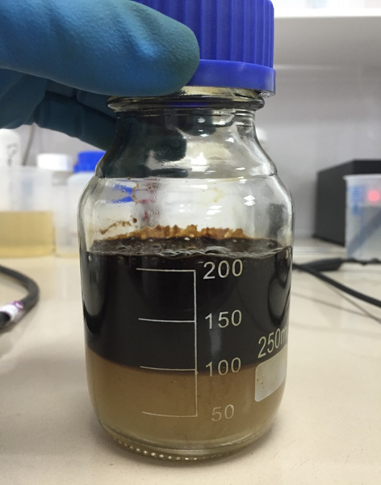
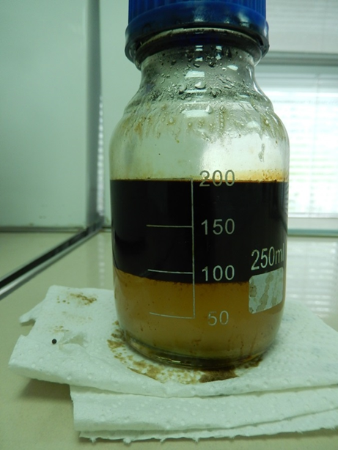
Auxiliary material - 5
Compatibility to formation fluid
ХВТ
Compatibility to formation fluid (Samotlor oilfield).
Left. broken emulsion ХВТ. 90% of emulsion broken in 30 min at 90°С.
Right. Broken emulsion with broken ХВТ fluid. 90% of emulsion broken in 10 hour at 90°С.

Slide 15
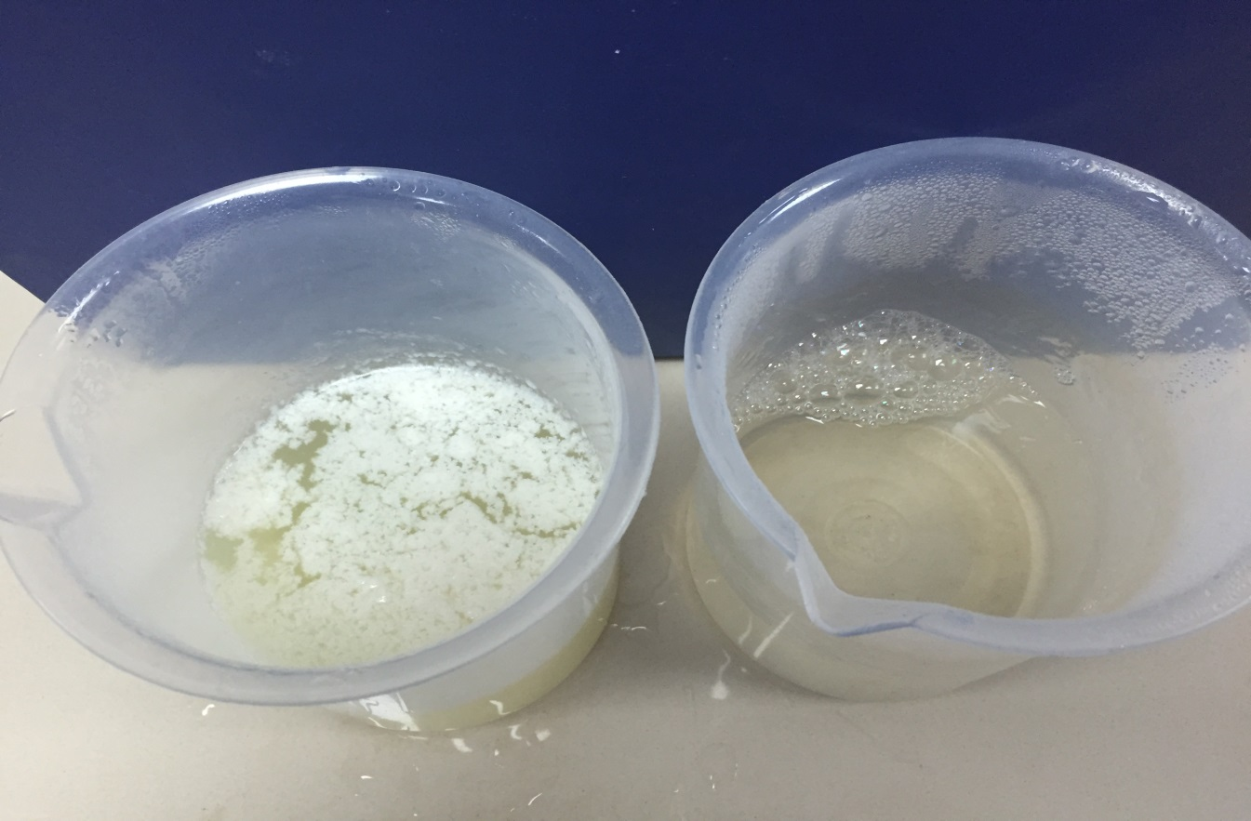
Auxiliary material - 6
Conditions of broken gel
ХВТ
Insoluble residues.
Frac fluid based:
guar (left) (gelant 3,6 кg/м³). ХВТ (right) (concentration 6 кg/м³).

Slide 16
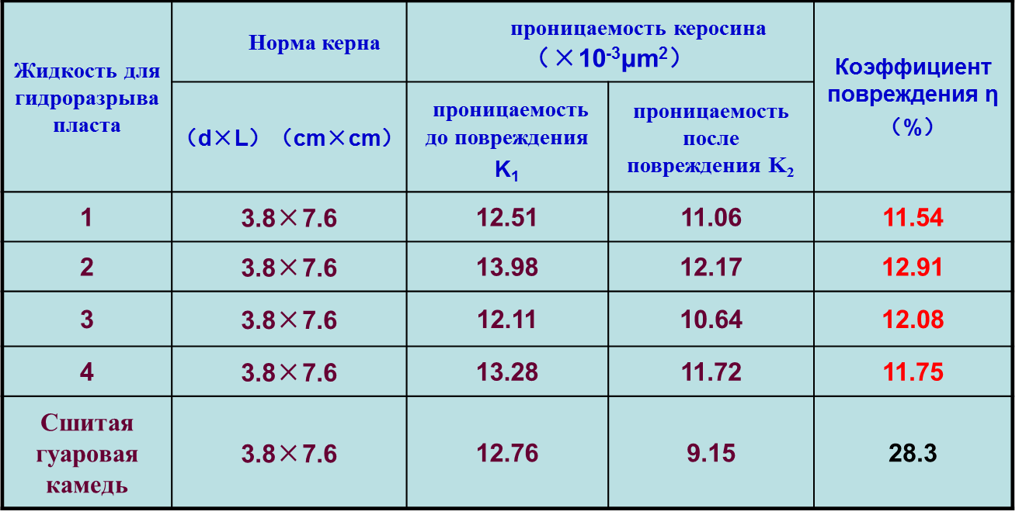
Auxiliary material - 7
Core test analysis. Formation damage
ХВТ
Results from producer.
Average value of formation damage from 4 ХВТ samples - 12.07%
Average value of formation damage from guar - 28.3%

